Slide 1
CRIME IN THE UNITED STATES
Pradeep Joseph

Slide 2
Why Study Crime Prevalence?
Determine whether public policy regarding crime has been effective over the course of past two decades
See where attention should be directed toward in order to bring down crime rate
Data obtained from FBI Uniform Crime Reporting: https://ucr.fbi.gov/crime-in-the-u.s/2012/crime-in-the-u.s.-2012/tables/1tabledatadecoverviewpdf/table_1_crime_in_the_united_states_by_volume_and_rate_per_100000_inhabitants_1993-2012.xls

Slide 3
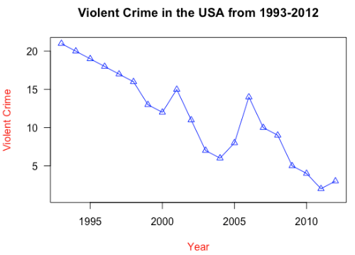
Violent Crime
Violent crime has decreased overall, with two surges of violent crime in 2001 and 2006.
R Code: plot(crimedata$Year, crimedata$Violent.crime, main='Violent Crime in the USA from 1993-2012', xlab = 'Year', ylab='Violent Crime', las=1, col='blue', type='o', col.lab='red', pch=2)

Slide 4
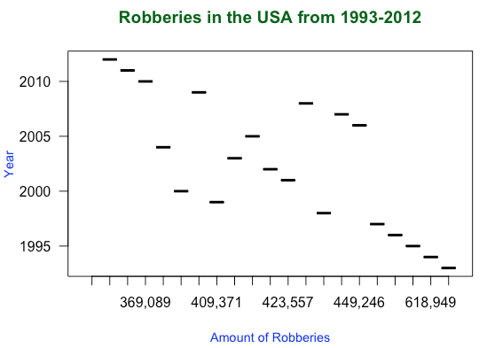
Robbery
Robberies, though generally less, have fluctuated over the past two decades.
R Code: boxplot(crimedata$Year~crimedata$Robbery, main='Robberies in the USA from 1993-2012', xlab='Amount of Robberies', ylab='Year', col.main='dark green', las=1, cex.lab=0.9, col.lab='blue')

Slide 5
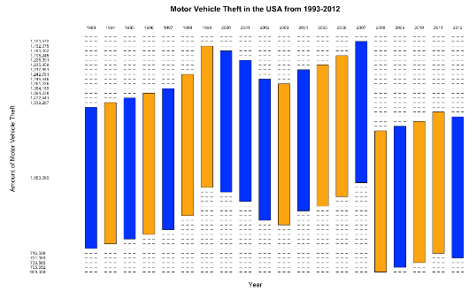
Motor Vehicle Theft
Motor Vehicle Theft has consistently declined over the past two decades.
R Code: mosaicplot(crimedata$Year~crimedata$Motor..vehicle..theft, main='Motor Vehicle Theft in the USA from 1993-2012', xlab='Year', ylab='Amount of Motor Vehicle Theft', las=1, color=c('orange','blue'))

Slide 6
Conclusion
In order to make most impact on cutting down on crime, public policies and resources should be focused on preventing violent crime and robberies, both of which have shown surges and fluctuations throughout the years.
Motor vehicle theft has been steadily decreasing and does not pose significant threat of surging

